Slide 1
Group 2
Paul Kruchko (EE)
Michael Laba (ME)
Bryan Jagielo (EE/CE)
Xiaoang Tong (EE)
Monika Shaeff (CE)
Ran Ao (ME)
Xinfeng Shi (ME)

Slide 2
Design Overview: Definition of our design
Our design is a closed-loop, feed-back, electronically controlled rotating part feeder that agitates, actuates, and organizes a set of homogenous hardware components that are to be counted and dispensed into the awaiting hands of the operator/user.

Slide 3
Part movement
Uses a bowl and wheel method to agitate, and dispense parts into awaiting presentation bin.
Uses geometry of replaceable disks to orient and move parts one at a time.
Gravity fed disk on 45 degrees.
Uses adjustable motor speed via PWM, using the armature current draw as feed back for velocity control, to ensure that the motor speed is sufficient for the part selected. Depending on the part, the PWM pulse duration and duty cycle is adjusted.

Slide 4
Part Movement continued
Gravity fed chute and presentation bin.
When bin is activated parts are dispensed in a controlled manor.
By limiting part feed to presentation bin to one at a time, we allow our sensors to accurately count each falling part.
Limiting the number of parts the disk can move at any given time allows for time to shut down the machine when part counts have been reached.

Slide 5
Frame
All features are contained in our compact frame.
Tight packaging in design limits our table space impact, also allows for the machine to be unplugged and moved.
Machine weighs approximately 5 pounds. Making it an easy machine to be moved by one person if needed.
20mmx20mm 80/20 extrude allows for parts to be assembled easily and by means of fastener. This allows for ease of service for parts replacement and if maintenance is needed.

Slide 6
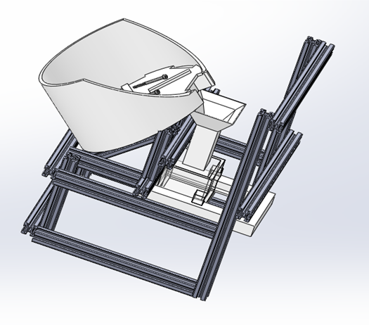

Slide 7
Printed Disks
Design had originally been 1 disk with inserts. (messy)
Fast installation for part switch
Maintain bowl inserts to keep disks thin and improve manufacturing time.
Agitators are thin but effective in mixing and orienting main part population.

Slide 8
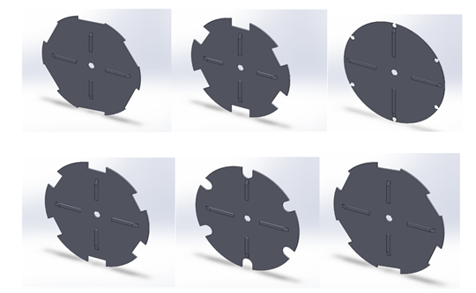

Slide 9
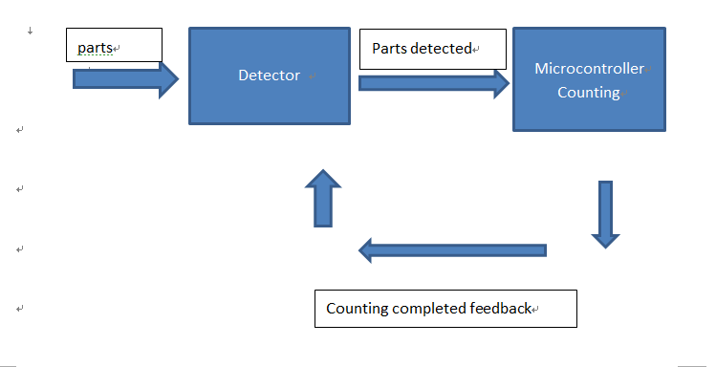
Device Performance and System controls (counting)- Flow chart

Slide 10
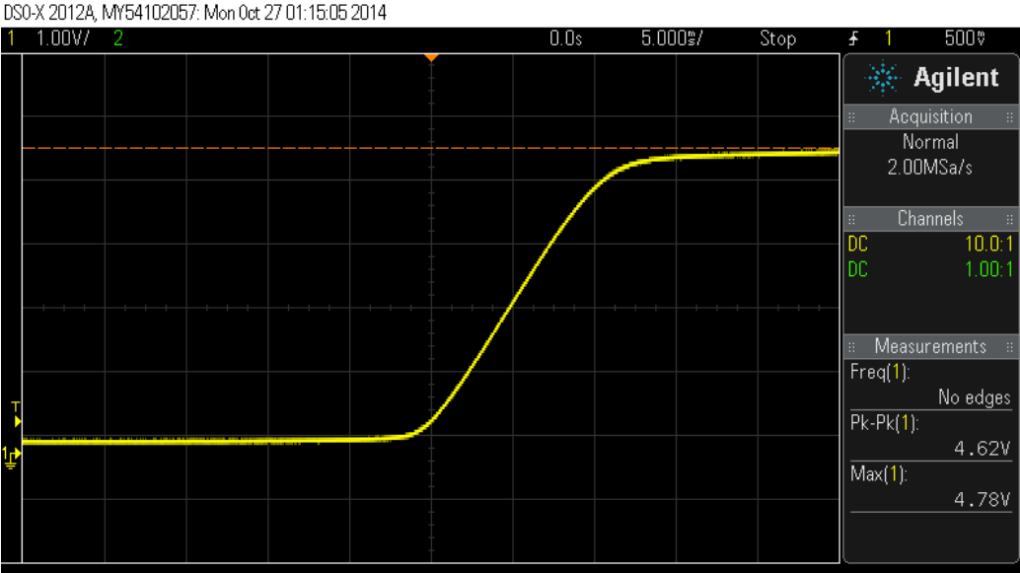
Device Performance and System controls (counting)
Detective System and Counting System:
1.Sensor : high Sensitivity-15us for rising edge (10+ testing for each part proofed)

Slide 11
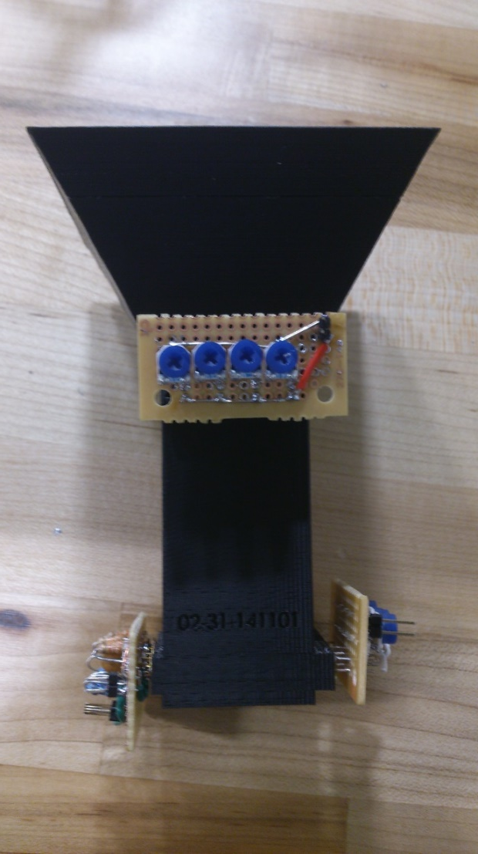
Device Performance and System controls (counting)
2.safety- 2 layers, grid structure . No gaps for parts escape detection system.
- Close spacing between sensors, less external
disturbance allowed during detection, more accurate.
- Gravity fed descent of the part. When the part goes
through the sensor, the fastest speed is approximately
2.2m/s. For a nut which has 4mm height, when it passes
the sensor it will take 1.82ms which is much higher than
our sensor’s reaction time of 15us.

Slide 12
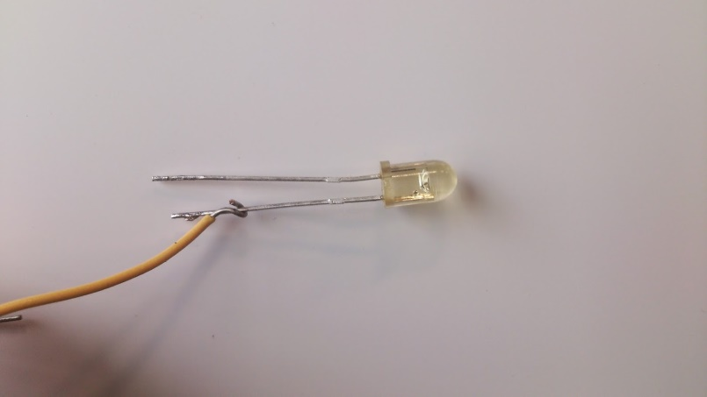
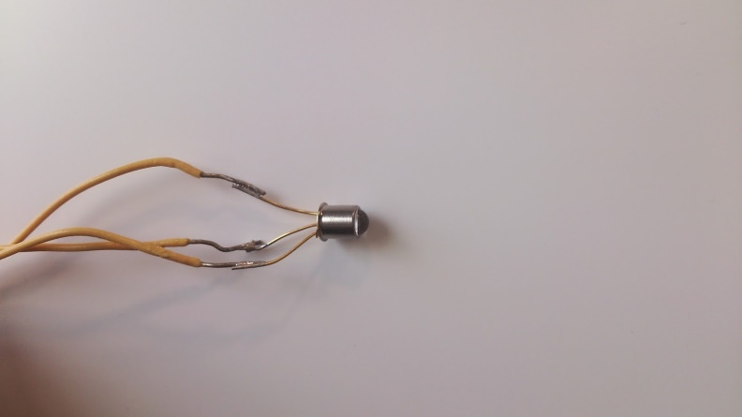
Device Performance and System controls (counting)
3. High efficiency Coding: state machine, enumeration, and structures
4. Minimize cost: Detection system was built using with the most basic component, and technique of IR sensor is already a mature technique at a reasonable price.

Slide 13
Device Performance and System controls (motor)
Use of a P and a PI controller allows responsive and proportional control of the motor speed by varying the PWM pulse duration and duty cycle.
Feedback is measured across a voltage divider on the current sense pin (CS) of an ST microelectronics VNH2SP30-E automotive fully integrated H-bridge driver.
The voltage that is measured by the Arduino’s A/D converter is proportional to the current that is being drawn by the motor.

Slide 14
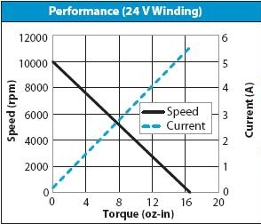
Device Performance and System controls (motor)
The current that is drawn by the motor is then linearly proportional to the torque that the motor experiences through the load, thus allowing the controller to vary the motor speed in accordance with the varying load torque.
Drawing peak current analogous to the stall current
causes the system to go into a shut-off mode to
protect the motor from destroying the armature.

Slide 15
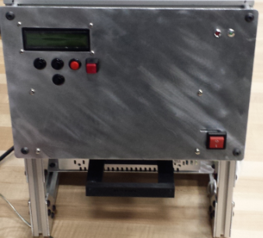
User interface
Use of LCD screen with push-button input that allows the user to select parts and counts.
User friendly interface which allows the user to pause the system working and to go back to previous step with pause and back button.
LEDs mounted to alert user when count is ready or if there is an error.
Easy power up and power down.
Part dispenser is user activated and provides feedback to system when parts have been dispensed.

Slide 16
How it all works
Parts are chosen and the machine is set up.
User interface selects parts and part count
Press select button to activate machine
The machine works for no more than 30sec before alerting the user that the count is ready.
User pushes on the parts slider like a soap dispenser, dropping the parts into the user’s hand and signaling to the machine that the count has been delivered.

Slide 17
Testing results
Initial testing revealed that the use of a common agitator and plate design with interchangeable inserts was ineffective.
It was difficult to design a locking mechanism that could be 3D printed and sufficiently engage the inserts so as not to allow them to fly off of the plate.
Larger agitators were favored for more oblong parts and slower moving disc speeds. Shorter, more streamlined agitators were favored for faster moving disc speeds and smaller more rounded objects.
Unless a control scheme is carefully implemented, the motor will actuate in such a way as to help cause a jamming condition.

Slide 18
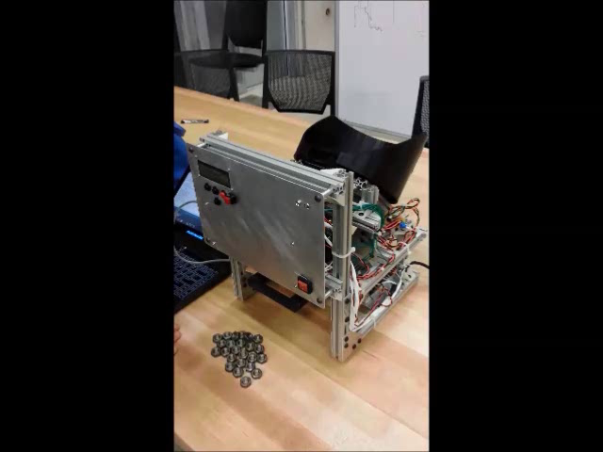
Video

Slide 19
Advantages
Product is easy to use and compact enough to fit on most desktops, shops, or on the production line of a manufacturing facility.
Parts are dispensed in 30 seconds and can be set to refill automatically after the user is finished dispensing.
The sensors are layered and set in a grid to ensure correct count.
All the ME/EE subsystems are all in the same whole frame, convenient to move and operate.(Optimized Structure)

Slide 20
Why we are going to win
From testing we are know that we are able to dispense each part accurately and in a timely fashion to meet the design requirements.
Our control scheme is robust enough to allow for system variations, such as the stochastic nature of tumbling parts. We have reliability on our side.
Our design also has the advantage of being not only in a small form factor, but also being aesthetically pleasing.
Our HMI is simple, intuitive, and user friendly.

Slide 21
Any Questions?

